Slide 1
Statistical learning and prediction
Tree and ensemble methods

Slide 2
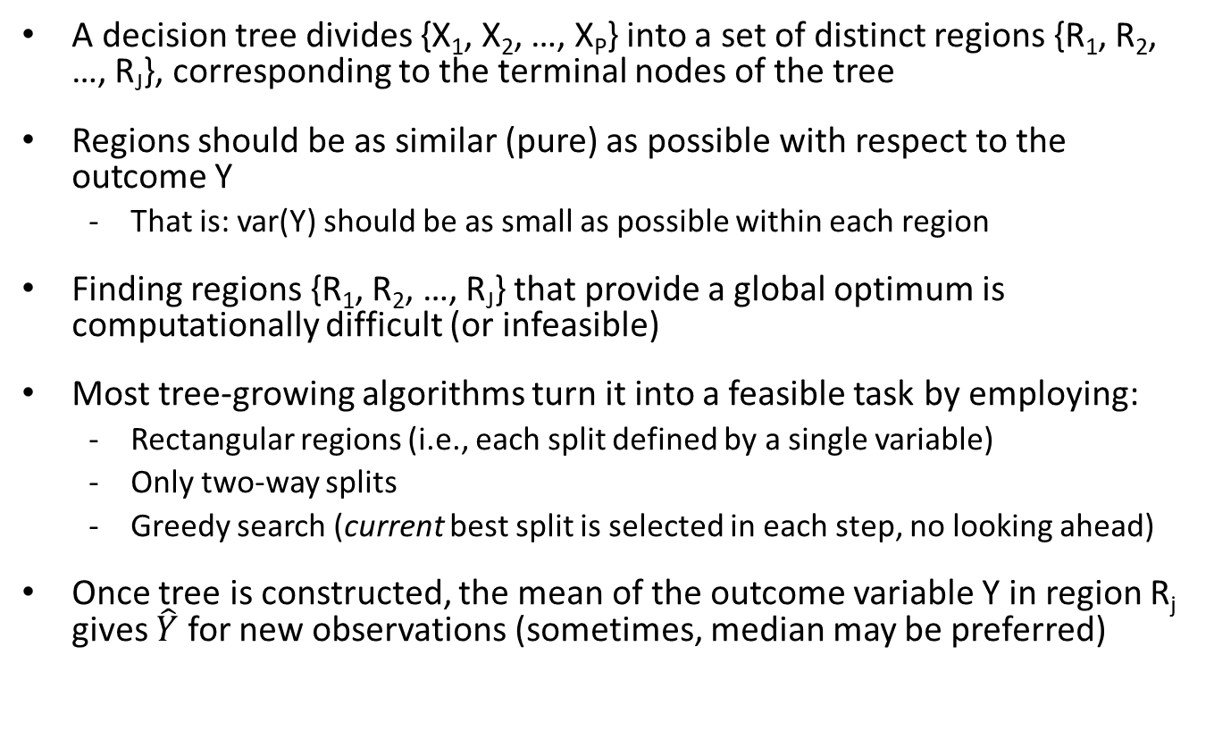
Tree-growing algorithms (e.g., CART)
A decision tree divides {X₁, X₂, …, X_{P}} into a set of distinct regions {R₁, R₂, …, R_{J}}, corresponding to the terminal nodes of the tree
Regions should be as similar (pure) as possible with respect to the outcome Y
That is: var(Y) should be as small as possible within each region
Finding regions {R₁, R₂, …, R_{J}} that provide a global optimum is computationally difficult (or infeasible)
Most tree-growing algorithms turn it into a feasible task by employing:
Rectangular regions (i.e., each split defined by a single variable)
Only two-way splits
Greedy search (current best split is selected in each step, no looking ahead)
Once tree is constructed, the mean of the outcome variable Y in region R_{j} gives $\hat{Y}$ for new observations (sometimes, median may be preferred)

Slide 3
Splitting criteria
At each step, we seek variable j and value s that define
R_{left}(j,s) = { X | X_{j} < s } and R_{right}(j,s) = { X | X_{j} ≥ s } ,
which minimize the sum of the loss function in both regions
Different loss functions can be used, e.g.,
Regression trees:
Absolute loss:
Squared error loss:
Classification trees:
Classification error:
Gini index:
Cross-entropy:
Squared error loss and Gini index are most often used
Both minimize variance among observations within every terminal node

Slide 4

Bias-variance trade-off
Trees do not provide optimal predictive accuracy, because:
Small trees have low variance, but (likely) high bias
Large trees have low bias, but high variance

Slide 5
Instability
Trees have high variance, a.k.a. instability:
A split may come out different due to minor sampling variations. Further splits are conditional on earlier splits -> Minor sampling variations may greatly affect the tree structure.
Looks very ugly if you look at the tree structure (e.g., add or remove only a few observations to the data and the whole tree may be different).
But note, very different tree structure may provide very similar predictions, due to correlated covariates. Instability may look worse than it is.

Slide 6
Balancing bias and variance
Solution 1: Pruning
tree should not be too small, nor too large
How?
grow full tree untill impurity cannot be further reduced
cut of branches by selecting the tree that minimizes the penalized loss function:
where T equals the # of terminal nodes; α should be determined by k-fold CV

Slide 7
Variable selection bias
CART performs exhaustive search: for every split, all possible splitting values are considered
-> biased variable selection: given two (or more) variables who are equally predictive of the outcome, variable with largest number of possible splitting values has higher probability of being selected for splitting
Solution: First select splitting variable, then select splitting value
-> unbiased variable selection: variables with equal predictive power have equal probability of being selected

Slide 8
Unbiased recursive partitioning
Conditional inference trees: Select splitting variable based on statistical tests
Separates variable and cutpoint selection
-> no selection bias towards variables with larger number of values
Solution 2 for balancing bias and variance: Yields natural stopping criterion: Significance level

Slide 9
Conditional inference trees
Statistical testing to select splitting variable:
H0_{j}: variable X_{j} and response Y are independent in the population
HA_{j}: variable X_{j} and response Y are dependent in the population
Thus, for each variable X_{j} a p value under H0 can be calculated, based on the observations in the current node
Variable X_{j} with lowest p value is selected for splitting the observations into two daughter nodes
If all p values in current node > pre-specified value α, no further splitting is performed
After selecting splitting variable, select cutpoint as with CART (i.e., take splitting value that yields minimum value of sum of loss functions in the two daugthernodes)
Implemented in R in ctree() function of package ‘partykit’

Slide 10
Exercise: Variable selection bias
Set the random seed and generate 200 observations from independent variables x1, x2 and e (you are free to choose the shape and parameters of the distribution yourself).
Create two datasets consisting of x1, x2 and y:
one where y = e (the 'independent' dataset), and
one where y = x2 + e (the 'dependent' dataset).
Using function tree() from the tree library, fit a regression tree using x1 and x2 to predict y, using each dataset.
Inspect the results using the plot() and text() functions. Which variable is most often selected for splitting? Is that what you would expect?

Slide 11
Exercise: Variable selection bias
Find the optimal number of nodes using the cv.tree() function. Plot the results. Prune the trees using function prune.tree(). Are there any splits left?
Use the ctree() function from the partykit package to fit a conditional inference tree to the independent and dependent data. Also plot the resulting conditional inference tree.
Compare the results you obtained in parts a, b, c and d.

Slide 12
Exercise: Dataset
Download the file MASQ.txt from github.
Read it into R using: read.table("MASQ.txt", header=TRUE)
It contains subscale scores of the Mood and Anxiety Symptom Questionnaire:
Anhedonic Depression (22 items):
Anxious Arousal items (17 items):
General Distress Depression (12 items)
General Distress Anxiety (11 items):
General Distress Mixed (15 items):
It also contains:
D_TOT (the total number of diagnoses present)
D_DEPDYS (whether a depressive or dysthymic disorder is present; make sure it is coded as a factor)
leeftijd (age)
geslacht (gender)
Separate data into 80% training and 20% test observations

Slide 13
Exercise: Regression tree
Fit a tree with function tree() from package tree:
Predict D_TOT using all other variables as predictors, except D_DEPDYS
Add min.dev = .002 as an argument (type ?tree.control to see what this does)
Inspect the tree using the print() function; plot the tree using the plot() and text() functions
Prune the tree:
Set the random seed and apply the cv.tree() function to obtain the optimal number of terminal nodes, inspect the CV results using plot(). What do the values on the x-axis and upper and lower y-axes represent?
Prune the tree using the prune.tree() function
Inspect the pruned tree using print(), plot() and text()
Compare performance:
Using the predict() function, compare the training and test MSEs of the unpruned and pruned trees
Note that D_TOT is a count variable. If you would model such a response with a linear regression model, which assumption would be violated? How would we fix that? Did we violate any assumptions by fitting a regression tree to a count response?
Fit a conditional inference tree to predict D_TOT, using the ctree() function from package partykit. Plot the results, and compare with the tree fitted above.

Slide 14
Tree ensembles
Single trees
Small trees have low variance, but high bias
Large trees have low bias, but high variance
Tree ensembles
By combining the fitted (predicted) values from a large number of single trees, variance is reduced
A price is paid in interpretability: instead of a single tree, we get a large number of trees

Slide 15
Ensemble learning
Predictions of a large number of weak learners (e.g., single trees) are combined to create a strong learner (e.g., ensemble of trees)
Other learners than trees may be ensembled, too
A weak learner is a method that has at least some predictive ability, that is at least better than random guessing
Predictive accuracy of the full ensemble is always equal or better than that of any of its constituent members

Slide 16
Ensemble learning
Ensembling works well for unstable learning algorithms
(algorithms whose output undergoes major changes in response to small changes in the training data)
Unstable learning algorithms (generally, relatively): e.g., decision trees, neural networks, rule learning algorithms, OLS regression
Stable learning algorithms (generally, relatively): e.g., penalized linear regression, nearest neighbour, linear threshold algorithms
Popular tree ensemble methods :
Bootstrap aggregation (bagging)
Random forests
Boosting

Slide 17
Bagging
Sampling rows of X decorrelates trees
A bagged tree ensemble is constructed by
Taking bootstrap samples from the training data
Fitting a tree on each of the bootstrap samples
Combining the trees into an ensemble

Slide 18
Random forests
Sampling rows of X
A random forest is constructed by
Taking bootstrap samples from the training dataset
Fitting a tree on each of the bootstrap samples, using a random subset of predictor variables for each split
Combining the trees into an ensemble
Sampling columns of X
Double decorrelation of trees and reduction of variance

Slide 19
Tuning parameters (bagging and random forests)
ntrees (# of trees / samples)
Sensible default: 500 (bagged and RF ensembles hardly overfit)
nodesize & maxnodes (treesize)
Sensible defaults:
nodesize: 1 for classification, 5 for regression
maxnodes: no limit (ensembling trees reduces variance, so trees may as well be large, with low bias)
mtry (# of predictor vars used for split selection)
Sensible default: mtry = p for bagging, mtry = srtq(p) for RF
replace (sampling with or without replacement)
Sensible default: Bootstrap sampling (replace = TRUE)
Bootrapping increases likelihood of noise variables being selected. Subsampling (replace = FALSE) may perform better in terms of variable inclusion frequencies (De Bin et al., 2014).

Slide 20
Out-of-bag error estimation
When trees are grown on bootstrap or sub samples of the data, we do not need separate test data for error estimation:
For each training observation i, predict Y using trees that were grown on samples not including observation i (out-of-bag)
Then calculate as usual:

Slide 21
Interpretation
The price for the better predictive accuracy of ensembles, compared to single trees, is interpretability
Variable importances aid in interpretation of the model
For bagging and random forests, relative importance of variable X_{j} is assessed as follows:
For every tree in the ensemble:
1) Predictive accuracy for OOB observations is computed
2) Predictive accuracy for OOB observations, with values of Xj randomly permuted are computed
Difference between accuracies under 1) and 2), averaged over all trees in the ensemble, is used to calculate importance of X_{j}

Slide 22
Boosting
The variance of the ensemble is reduced more when trees (and predictions) are less correlated
Bagged ensembles decorrelate through sampling of observations
Random forests doubly decorrelate through sampling observations as well as variables
Boosting decorrelates trees through growing them sequentially: each tree is grown on the residuals of earlier trees

Slide 23
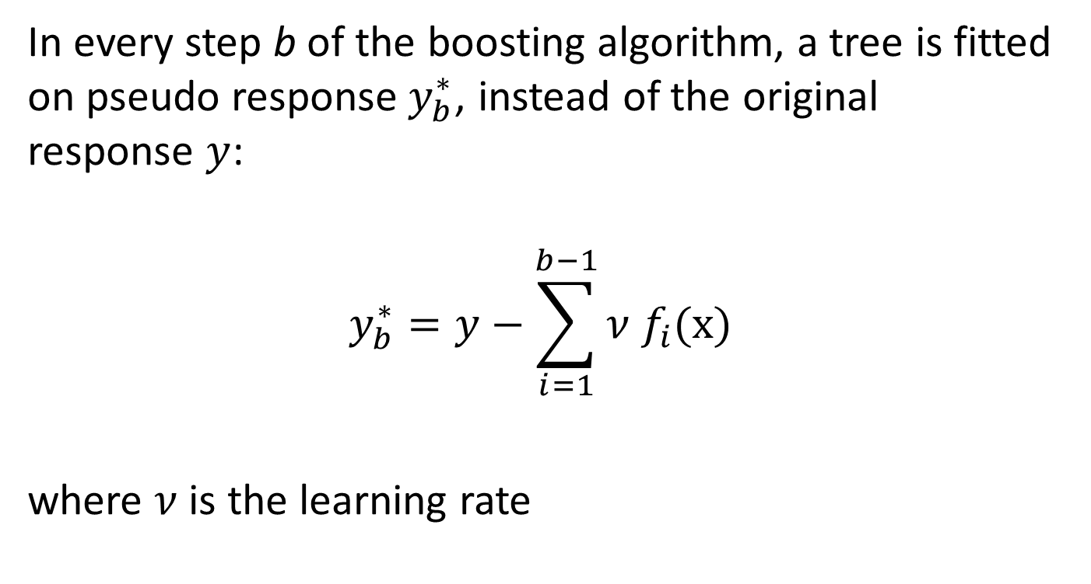
Pseudo response variable in boosting
In every step b of the boosting algorithm, a tree is fitted on pseudo response$y_{b}^{∗}$, instead of the original response $y$:
$$y_{b}^{∗}=y−\sum_{i=1}^{b−1}{ν f_{i}(\text{x})}$$
where $ν$ is the learning rate

Slide 24
Tuning parameters (boosting)
Boosting can overfit, have to determine optimal parameter values by CV!
interaction.depth (tree depth):
Should be relatively low (boosting works best with weak learners)
Rule of thumb: interaction.depth = 4
n.trees (# of trees):
Rule of thumb: at least 1 / shrinkage
shrinkage (learning rate):
At least 1 / n.trees
bag.fraction (fraction of training observations randomly selected for each sample)
Bootstrap sampling (bag.fraction < 1) or no sampling (bag.fraction = 1)

Slide 25
Trees and ensembles: Concluding remarks
With a single tree, we trade in some predictive accuracy for interpretability
Depends on the context of the application if this is worth it, e.g.
Simple decision trees are pre-eminently suited as tools for human decision making (i.e., their use requires limited time and computational power)
Tree ensembles generally use all of the predictor variables: evaluation of all variables for new cases may be expensive / infeasible
If we have lots of data and computation power available, tree ensembles provide very good predictive accuracy
Boosting requires careful parameter tuning to perform well, random forest works well out-of-the-box

Slide 26
Exercise: Bagging
Download last week’s MASQ.txt dataset from BlackBoard, use the same train and test sets as last week
Fit a bagged ensemble to the D_TOT outcome using the randomForest package and function
Make sure D_DEPDYS is not included as a predictor
Make sure to set the random seed first
For a bagged ensemble, set mtry = p
Check ?randomForest to figure out:
How many trees are generated by default?
Is bootstrap or subsampling employed by default? How can you change this?
Which arguments are used to control tree depth and what are the defaults?
Use importance() and varImpPlot() to see which variables are most important for predicting the outcome
Use partialplot() to obtain partial dependence plots for AD, GDD and geslacht
Use plot() to see how the OOB error decreases as a function of the number of trees
Use predict() to assess the train and test MSE

Slide 27
Exercise: Random forest
Fit a random forest to D_TOT using the randomForest function
For a random forest, set mtry = sqrt(p)
Use importance() and varImpPlot() to see which variables are most important for predicting the outcome
Use partialplot() to obtain partial dependence plots for AD, GDD and geslacht
Use plot() to see how the OOB error decreases as a function of the number of trees
Use predict() to assess the test MSE

Slide 28
Exercise: Boosting
Fit a boosted ensemble to the D_TOT outcome using the gbm package and function
Make sure to set the random seed first
Check ?gbm to figure out:
How many trees are generated by default?
Which argument is used to control the observation sampling strategy employed for fitting each tree? What is the default of this argument?
Which argument is used to control tree depth and what is the default?
Which argument is used to control the learning rate or shrinkage?
Fit a boosted ensemble with a learning rate of 0.01, the default tree depth, and 1,000 trees
Fit a second boosted ensemble with a learning rate of 0.1, the default tree depth, and 1,000 trees
Use gbm.perf() with argument oobag.curve=TRUE to see how OOB error decreases as a function of the number of trees, for the two boosted ensembles
Use plot() with argument i.var to obtain partial dependence plots for AD, GDD and geslacht, for the two boosted ensembles
Use summary() to obtain variable importances, for the two boosted ensembles
Use predict() to assess the test MSE, for the two boosted ensembles

Slide 29
Exercise: Parameter tuning through CV
With the following code we can estimate which parameter settings can be expected to yield the best predictive accuracy for the boosted ensemble:
library("caret")
grid <- expand.grid(shrinkage = c(.1, .01, .001),
n.trees = c(10, 100, 1000),
interaction.depth = 1:4,
n.minobsinnode = 10)
grid
set.seed(3)
gbmFit <- train(D_TOT ~ ., data = MASQ[train,],
method = "gbm", tuneGrid = grid)
gbmFit
gbmFit$bestTune
If the best parameter values differ from those you used before to fit the boosted ensemble, refit the ensemble using the best parameter values and again assess test MSE
NB1: Parameter values for the randomForest() function can also be tuned using method = 'rf’ with caret
NB2: See http://topepo.github.io/caret/train-models-by-tag.html# for all models that can be tuned using caret

Slide 30
Suggested further reading
Introduction to trees and random forests:
Strobl, C., Malley, J., & Tutz, G. (2009). An introduction to recursive partitioning: rationale, application, and characteristics of classification and regression trees, bagging, and random forests. Psychological Methods, 14(4), 323.
Unbiased recursive partitioning:
Hothorn, T., Hornik, K., & Zeileis, A. (2006). Unbiased recursive partitioning: A conditional inference framework. Journal of Computational and Graphical statistics, 15(3), 651-674.
Boosting and ensemble learning:
Bühlmann, P., & Hothorn, T. (2007). Boosting algorithms: Regularization, prediction and model fitting. Statistical Science 22(4), 477-505.
Trees for multilevel data:
Fokkema, M., Smits, N., Zeileis, A. , Hothorn, T. & Kelderman, H. (2018). Detecting treatment-subgroup interactions in clustered data with generalized linear mixed-effects model trees. Behavior Research Methods, https://doi.org/10.3758/s13428-017-0971-x
GAMs:
An introduction to GAMs by simon wood (author of mgcv): https://people.maths.bris.ac.uk/~sw15190/talks/snw-Koln.pdf

